Slide 1
Destinations searching application
Created by
Oleksandra Ostra
Polish-Japanese Academy
of Information Technologies
Specialization ”Databases”

Slide 2
Looking for best places to go for adventure?
Want to find people to share your passion with?

Slide 3
photography backpacking hiking climbing rock climbing mountaineering caving cycling downhill caving canoeing skiing/snowboarding slope park big air freeriding diving technical diving freediving water skiing wakeboarding surfing windsurfing kitesurfing bungee jumping vlogging skydiving hang-gliding wingsuit photography video making backpacking hiking climbing rock climbing mountaineering caving cycling downhill caving canoeing skiing/snowboarding slope park big air freeriding diving technical diving freediving water skiing wakeboarding surfing windsurfing kitesurfing bungee jumping paragliding skydiving hang-gliding wingsuit blogging jumping

Slide 4

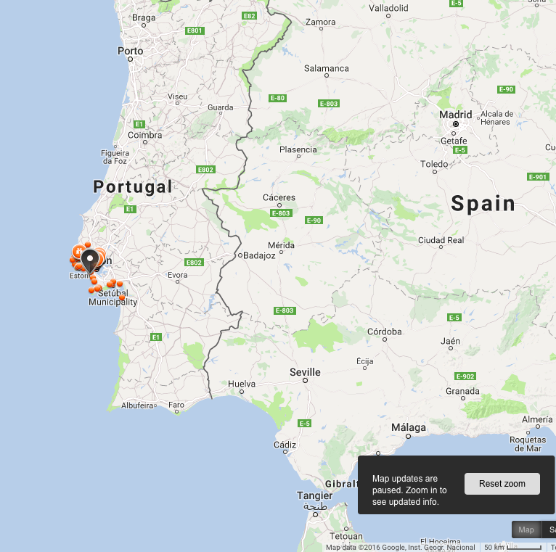
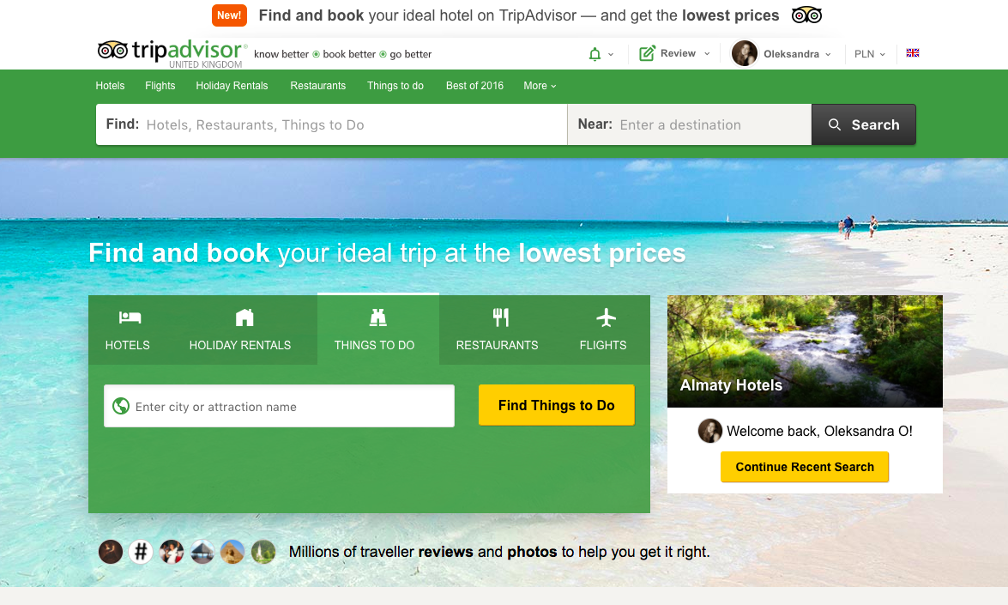

Slide 5
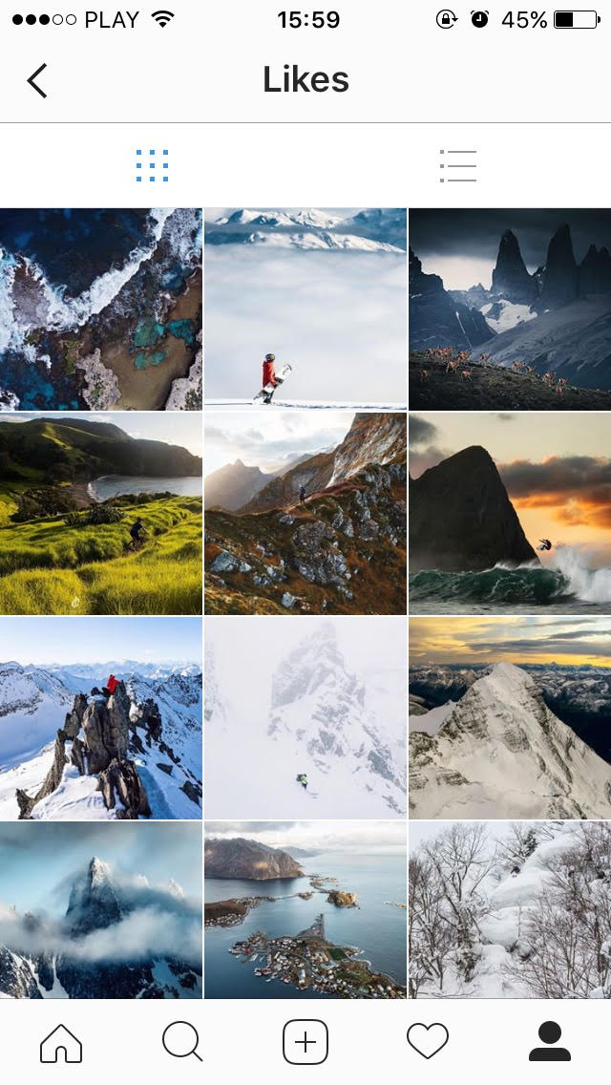
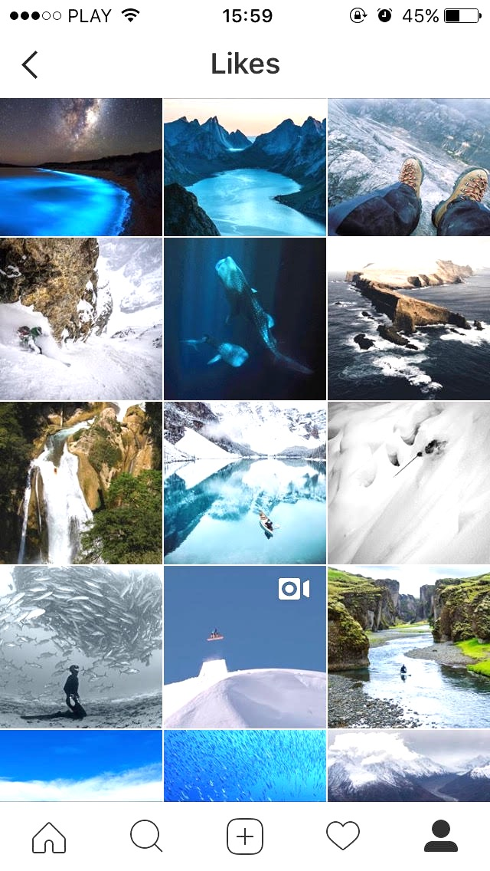

Slide 6




Slide 7
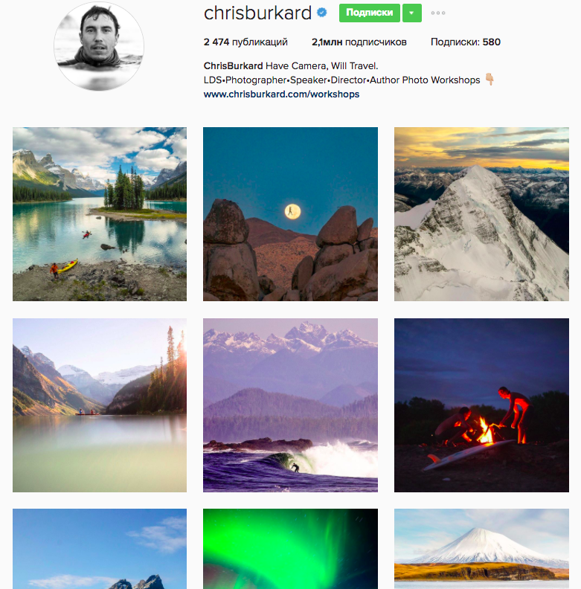
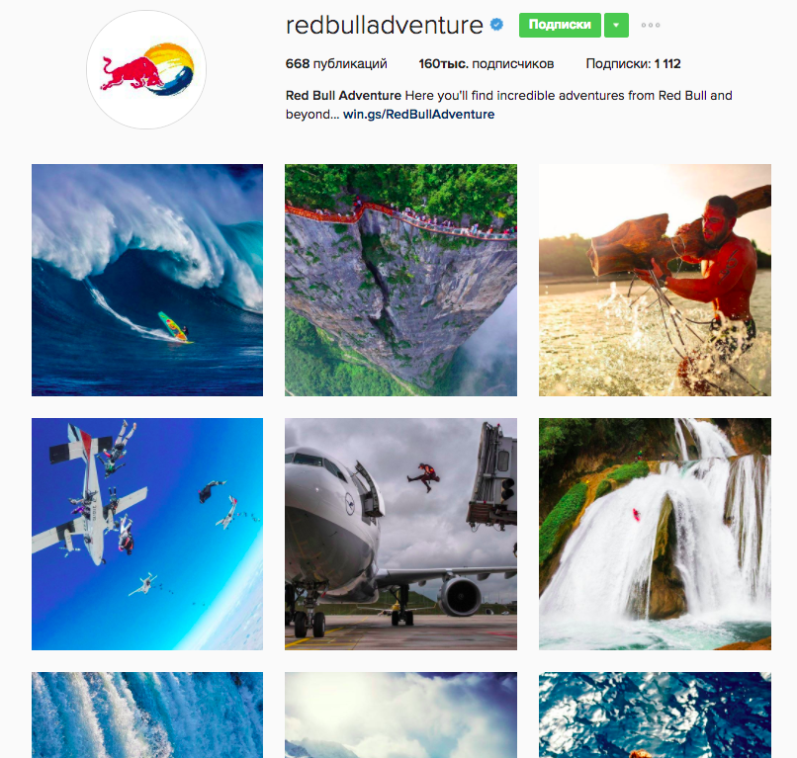

Slide 8
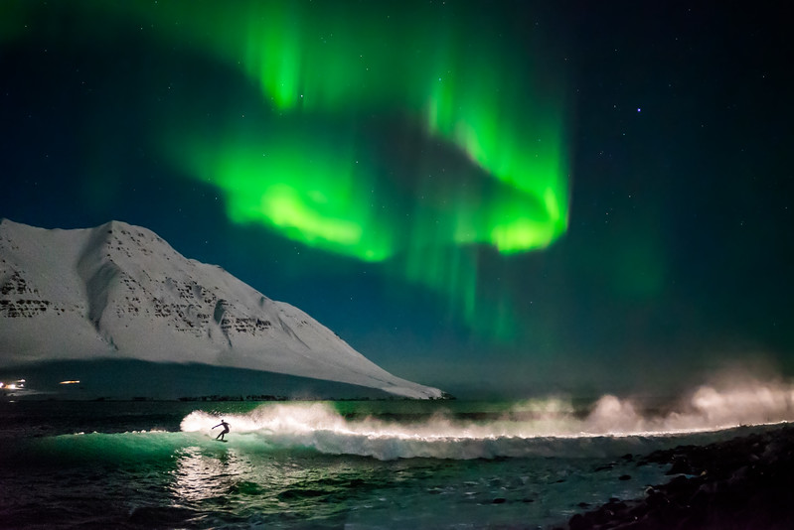

Slide 9
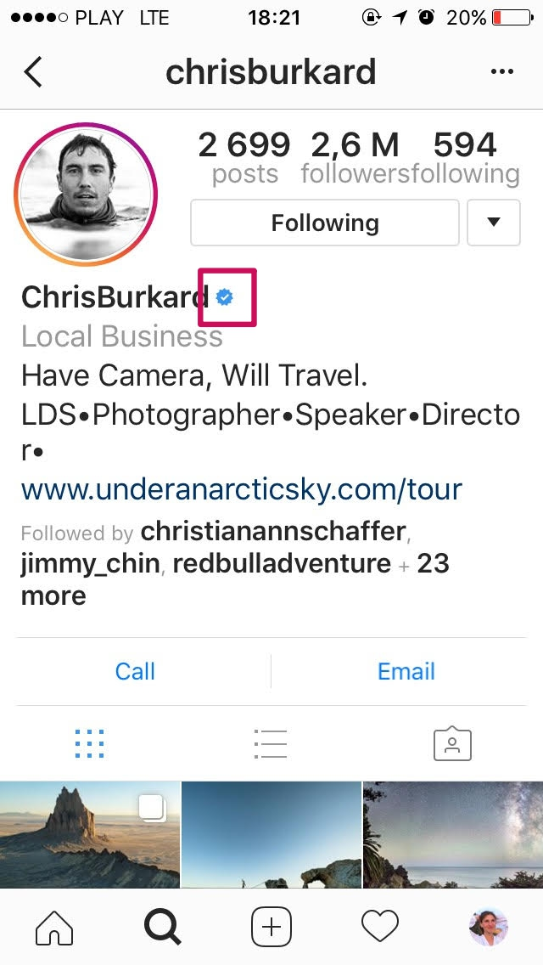
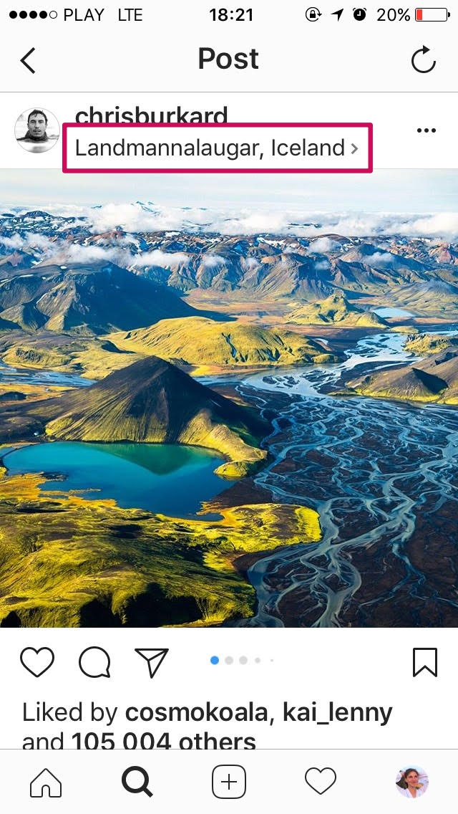
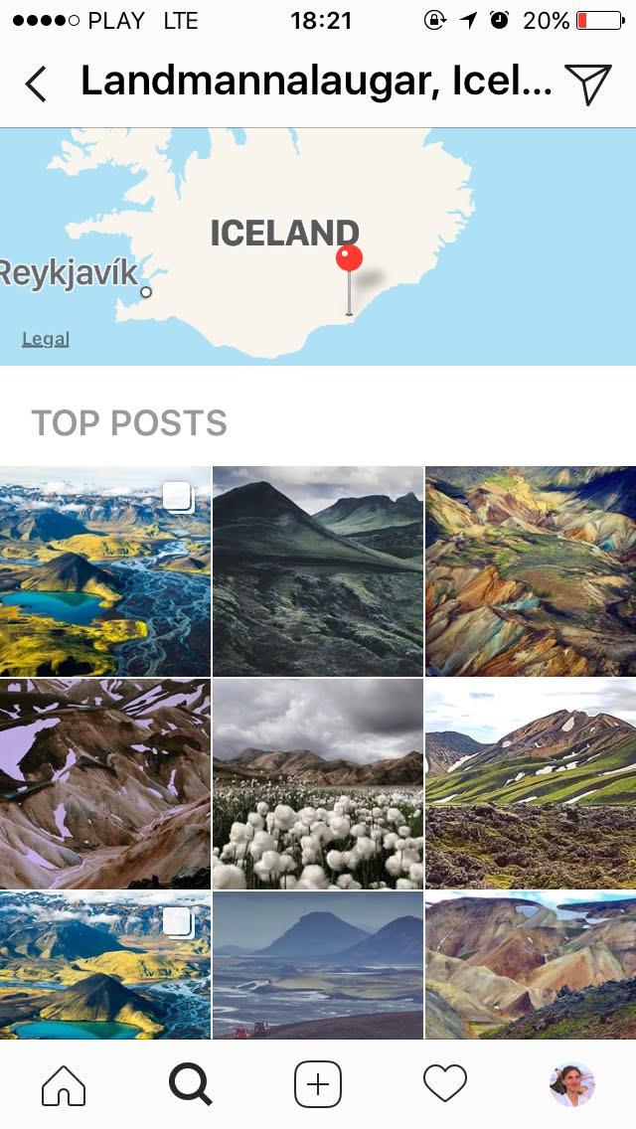
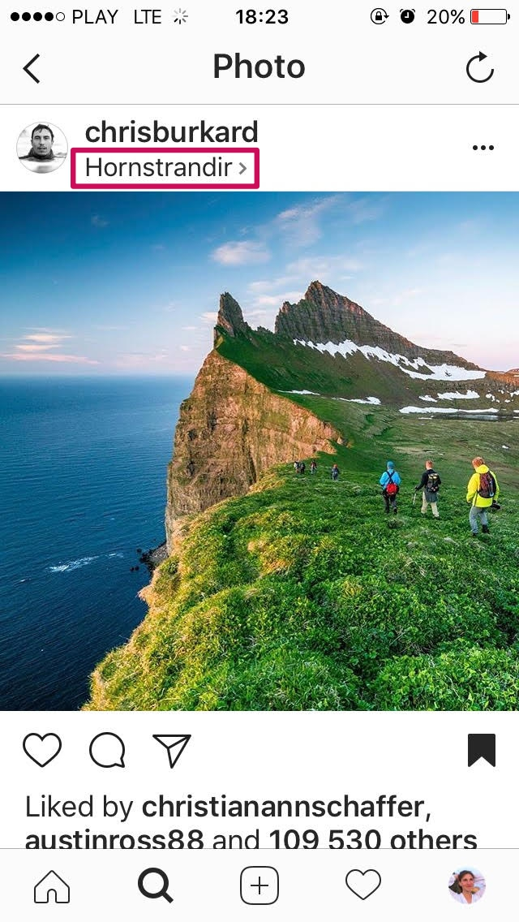
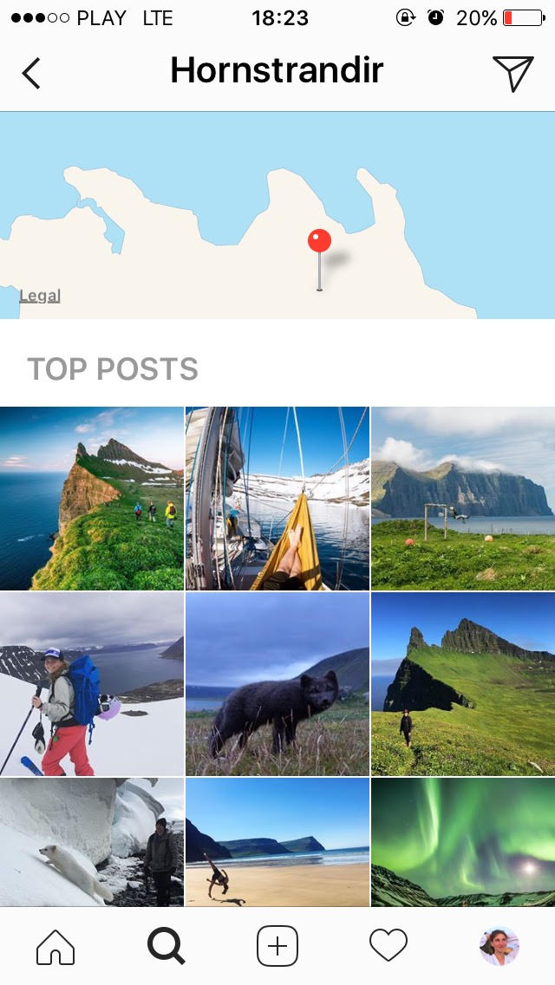

Slide 10
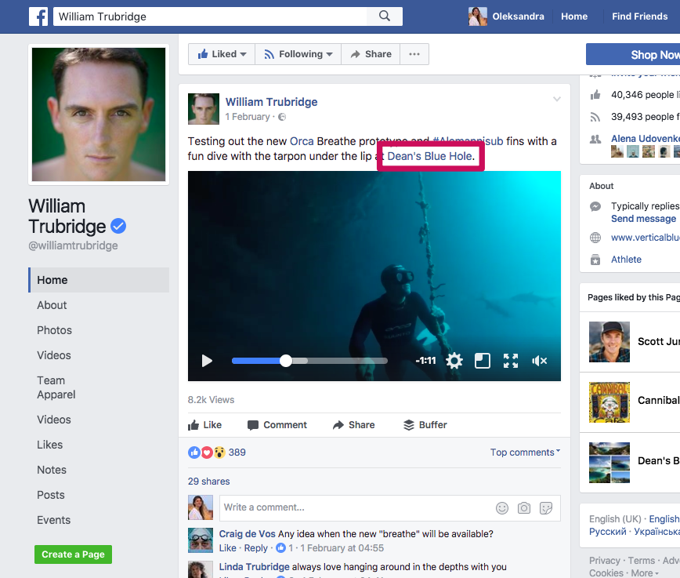
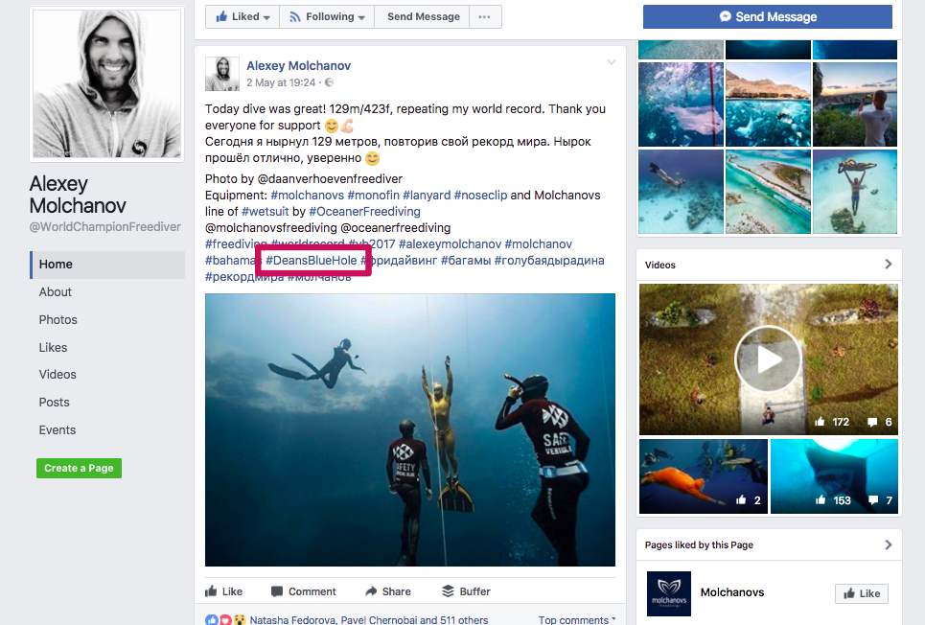

Slide 11
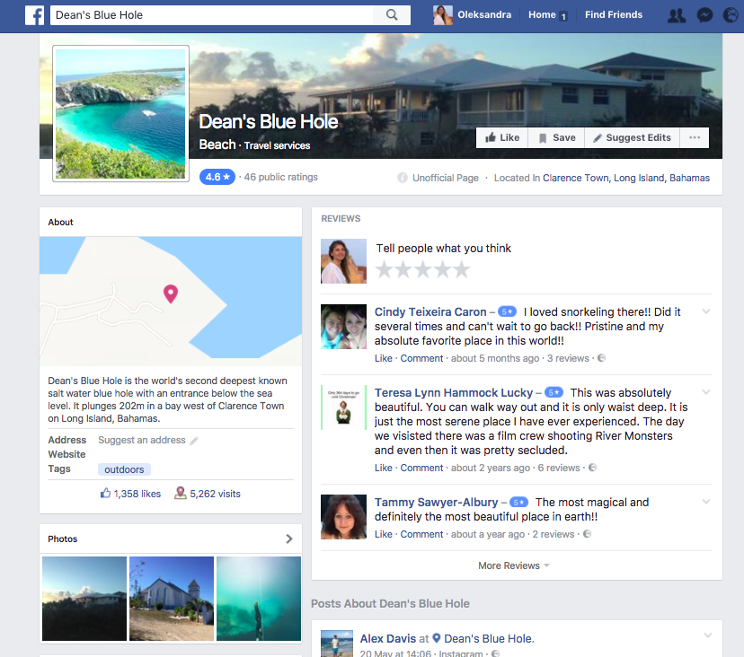

Slide 12
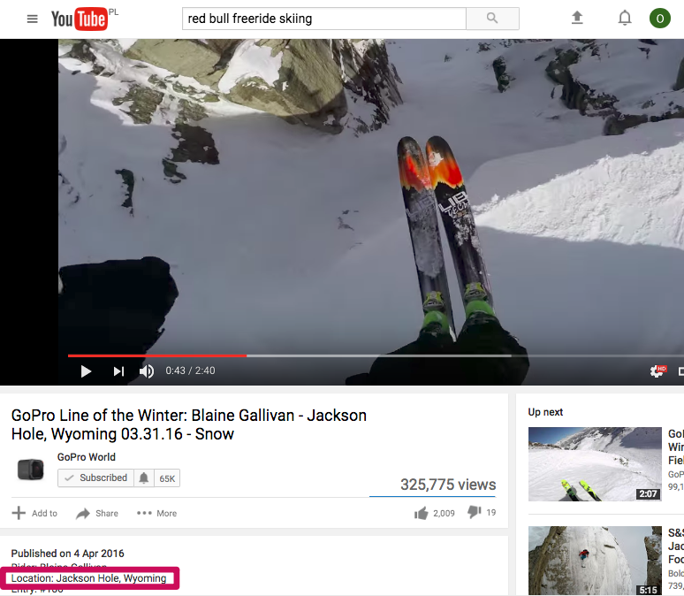

Slide 13
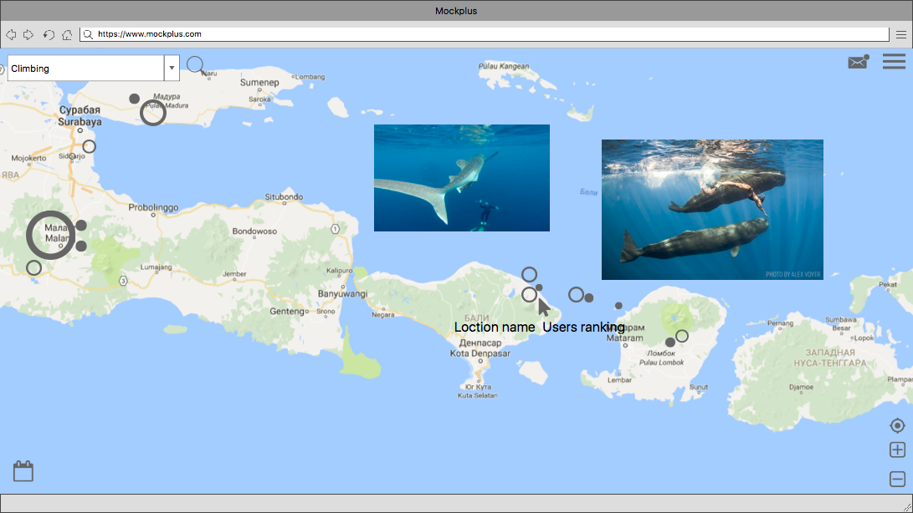

Slide 14
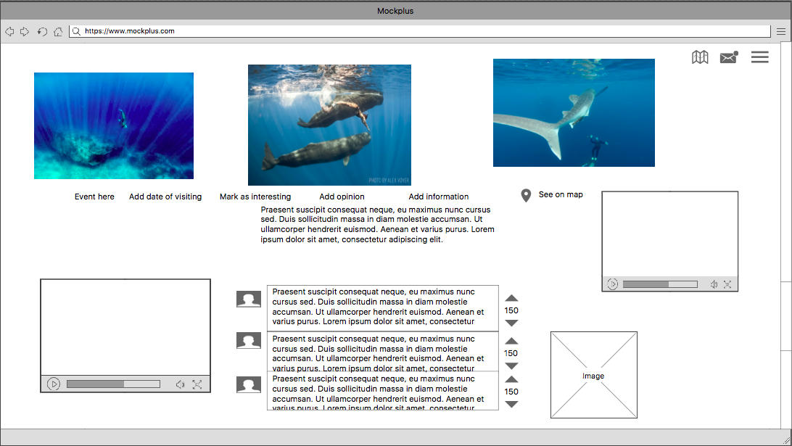

Slide 15
Best location
People who also want to go
Services and other centers
Equipment and other stores
Instructors, photographers and other
Competitions and other events
Communications with other users
Groups
Staying up to date buy following other users

Slide 16
Web application C# ASP.NET
Android application Java
iOS application Swift
Web scraping application Python
JSON data format
C# Xamarin
API Facebook, Instagram, YouTube

Slide 17
This is the end
Thank you for your attention!

